Slide 1
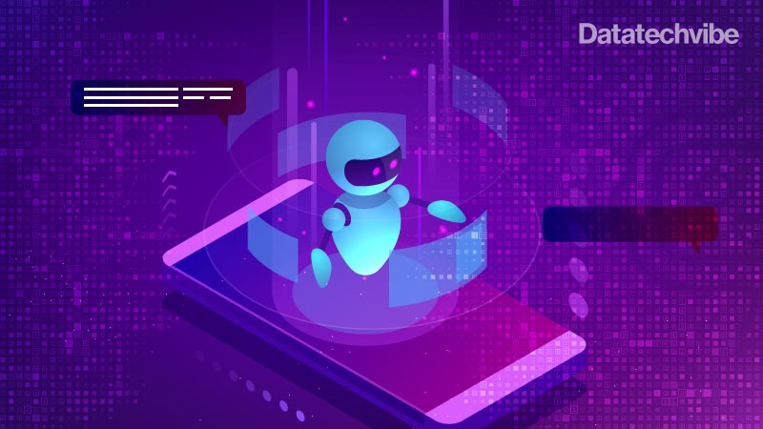
Create a chatbot with python
Name: Mubeena E M Reg.No:513521104028
Department: CSE Year: III
NM ID: au513521104028
Email:mubeenacse28@gmail.com

Slide 2
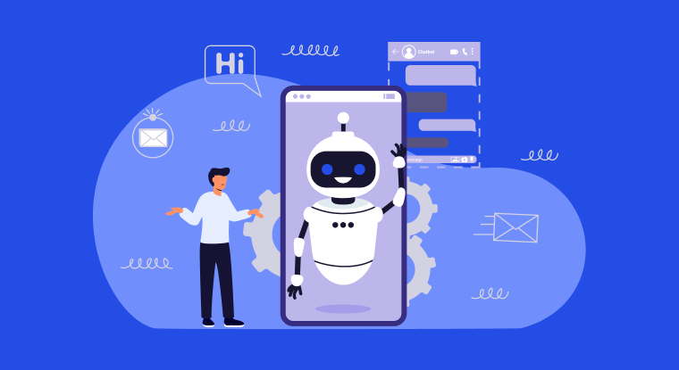
Problems Statement:
In this fast-digital era, people overwhelmed with information and tasks like (interactions, businesses, websites and applications).
The challenges is to create a sophisticated and efficient chatbot using python.Chatbot using python must be capable of
Understanding natural language
Generating contextually relevant responses
Seamlessly integrating into various platforms.

Slide 3
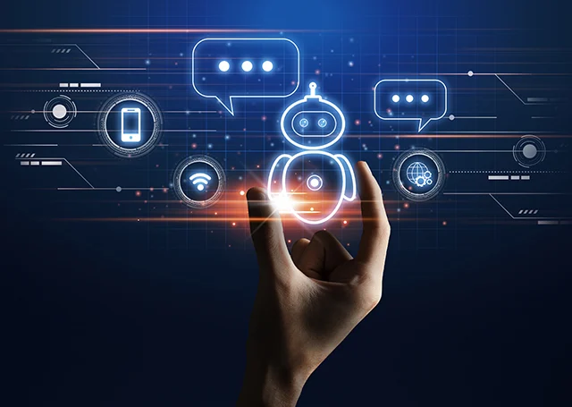
PROBLEM OVERVIEW:
In the age of rapid technology advancement, people are increasingly relying on digital solutions to simplify the lives.
1.Natural Language Processing (NLP) : Handling various language nuances, slang, and informal language used in day-to-day conversations.
2.Task management: In implementing remainder functionalities and ensuring timely notifications without being intrusive.
3.Information retrieval: Ensuring the retrieved information is relevant, up-to-date, and reliable.
4.Personalization and user experience: Creating a seamless and user-friendly interface, whether through a command line interface (CLI) or a graphical user interface (GUI).
5.Error handling and context management: Managing conversation context to provide coherent responses, specially in multi-turn conversations.
6.Data security and privacy: Implementing protocols to safeguard user data from potential threats are breaches.

Slide 4
PROBLEM DEFINITION:
Develop a chatbot to enhance customer support services for an e-commerce platform.
The chatbot should provide users with quick and accurate responses to their queries, offer product recommendations, assist in the purchasing process, and handle common customer service tasks.
The chatbot should be implemented using Python and natural language processing techniques to ensure a seamless and efficient user experience.
ABSTRACT:
This research project explores the integration of Python programming language and natural language processing techniques
It is to create an intelligent chatbot tailored for user engagement and efficient customer support.
This study delves into the implementation of advanced algorithms for natural language

Slide 5
DESIGN THINKING:
Design thinking is a problem-solving approach that focuses on understanding the user's needs, challenging assumptions, and redefining problems to create innovative solutions. When applying design thinking to create a chatbot with Python, you can follow these steps:
Functionality
User interface
Natural language processing
Responses
Integration
Testing and improvement
Conclusion

Slide 6
Functionality:
SCOPE OF CHATBOT:
Chatbots can provide instant assistance to customers, which can help reduce wait times and improve customer satisfaction.
In the future, chatbots may become even more sophisticated and be able to handle more complex customer service interactions.
User Interface:
DESINGN A USER FRIENDLY INTERFACE:
To design a user friendly interface for a chatbot to knows your audience the way they are more easily to interact
To analyze the purpose for the chatbot to be created . Depending on this the interface of the chatbot are designed.
If the chatbot are created for personal or business purpose the chatbot is to be created the interface is where the chatbot has been performed then the Chatbot interface is made up with a personal id and password in thew interface.

Slide 7
Natural Language processing:
Natural language processing is a field of study in artificial intelligence (AI) and computer science that focuses on the interactions between humans and computers using natural language.
It involves the development of algorithms and techniques to enable machines to understand, interpret, and generate human language, allowing computers to interact with humans in a way that is more intuitive and efficient.
Conversational AI chatbots are computer programs that simulate conversation with human users in natural language.
Responses:
The simplest thing to do when writing responses to command and inquiry utterances in a conversational UI is to get straight to the point: respond with facts. That’ll remove a lot of the ambiguity and simplify your dialogue.
When you want to give your bot more personality and make the conversation feel more natural, include an acknowledgement response before fulfilling the request.

Slide 8
Integration:
The Chatbot will be integrated with a website that we were created at the time for submission.
The Website that are integrated with the python program to create a Chatbot using Python Program
Inserting the chatbot on your site couldn't be easier. Beneath the chatbot builder, there's a short code that you can use to insert the chatbot into a page or post on your WordPress site.
Testing and improvement:
Conversational interfaces let you connect with customers at scale and 24/7. However, when they fail to deliver a great customer experience, they also do it at scale. Therefore, testing should be the key aspect of any chatbot development process. It helps evaluate your bot's performance in terms of accuracy, speed, and usefulness. It can also give hints on improving your bot's language and personality or which features to add or remove to streamline the flow.
Additionally, 73% of consumers declare that if they had a bad user experience with a virtual assistant, they wouldn't use it again. Pre-launch testing can help you polish your chatbot and build user trust in your chatbot customer service.

Slide 9
Conclusion:
A chatbot is one of the simple ways to transport data from a computer without having to think for proper keywords to look up in a search or browse several web pages to collect information; users can easily type their query in natural language and retrieve information.
In this paper, information about the design, implementation of the chatbot has been presented. From the survey above, it can be said that the development and improvement of chatbot design grow at an unpredictable rate due to variety of methods and approaches used to design a chatbot.
Chatbot is a great tool for quick interaction with the user. They help us by providing entertainment, saving time and answering the questions that are hard to find.
General purpose Chatbot must be simple, user friendly, must be easily understood and the knowledge base must be compact. Although some of the commercial products have recently emerged, improvements must be made to find a common approach for designing a Chatbot.

